Slide 1




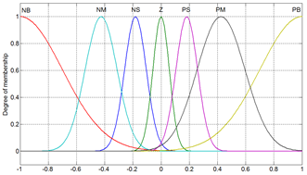
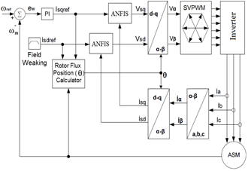
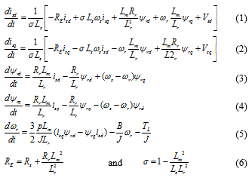
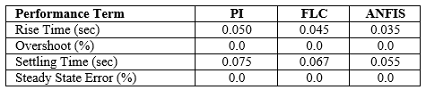
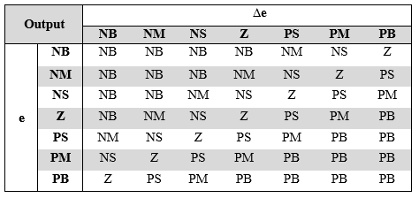

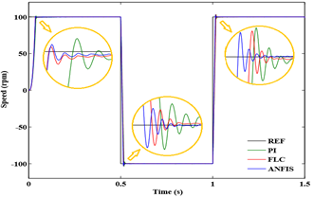
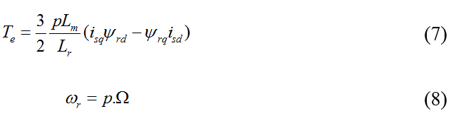
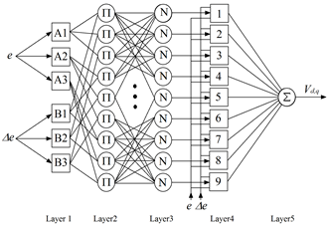
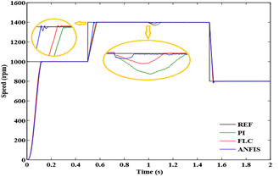
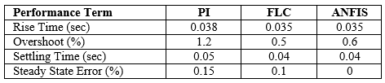


A Comparative Analysis of FLC and ANFIS Controller for Vector Controlled Induction Motor Drive
Erdal Kılıç¹, Hasan Rıza Özçalık², Şaban Yılmaz³, Sami Şit⁴
1-Department of Electrical and Electronics Engineering, Kahramanmaras Sutcu Imam University, Kahramanmaras, Turkey, ekilic@ksu.edu.tr
2-Department of Electrical and Electronics Engineering, Kahramanmaras Sutcu Imam University, Kahramanmaras, Turkey, ozcalik@yahoo.com
3-Department of Electrical and Electronics Engineering, Kahramanmaras Sutcu Imam University, Kahramanmaras, Turkey, sabanyilmaz1@hotmail.com
4-Department of Electrical and Electronics Engineering, Kahramanmaras Sutcu Imam University, Kahramanmaras, Turkey, samisit@hotmail.com
Abstract— This paper presents an adaptive neuro-fuzzy inference system (ANFIS) based speed control for indirect field oriented controlled induction motor drive. The obtaining of maximum torque and efficiency in the motor necessitates a successful nonlinear speed control method due to the non-linear structure of the system. In this work, a fuzzy logic controller (FLC) and ANFIS controller has been developed for speed control of induction motors. Parameters of ANFIS are tuned with on-line direct self-tuning method. The performance of proposed controllers has been examined in different working conditions. Simulation studies shows robustness and suitability of drive for high performance drive applications.
Keywords— adaptive neuro-fuzzy control; fuzzy logic control; vector control; induction motor, self-tuning.
DYNAMIC MODEL OF INDUCTION MOTOR
A dynamic model of the induction motor to be controlled must be known in order to understand, analyze and design vector controlled drives. It has been found that the dynamic model equations developed on a rotating reference frame is easier to describe the characteristics of induction motors. Differential equations in synchronously rotating d-q reference frame model can be arranged as follows in order to induction motor.
where ωs and ωr are respectively, electrical synchronous stator and rotor speed, Vsd , Vsq, isd , isq , ψrd and ψrq are stator voltages, stator currents and rotor fluxes d-q components reference frame; Rs and Rr are stator and rotor resistances, Ls and Lr are stator and rotor main inductances, Lm is mutual inductance between stator and rotor, p is number of motor poles, J is system inertia, B is viscous friction coefficient, TL is load torque, RE is equivalent resistance, σ is leakage coefficient. The electromagnetic torque and electrical rotor speed that linked to shaft motor speed as given by:
The motor slip frequency can be calculated from the reference values of the stator current components as follow:
follow:
Rotor flux position is given by:
Because of the multiplication terms of state variables, the induction motor model is the nonlinear state equations. The state variables are isd, isq, ψrd, ψrq and ωr.
Fig. 1.Structure of fuzzy logic controller
Fig. 2.Membership function for inputs and outputs variables.
Table 1. Fuzzy Rules
Anfis Controller
ANFIS, proposed by J.S.R. Jang [26, 33], is an intelligent technique and is proved to be efficient in problems like classification, modeling, and control of complex systems. ANFIS are realized by an appropriate combination of neural and fuzzy systems. The premise parameters and consequent parameters are tuned using back-propagation algorithm. The proposed neuro-fuzzy controller incorporates fuzzy logic algorithm with a five layer artificial neural network (ANN) structure as shown in Fig. 3. ANFIS architecture that has two inputs e and ∆e and one output Vd (or Vq).
Fig. 3.Structure of ANFIS controller for induction motor
SIMULATION
The system for vector control induction motor is simulated in MATLAB software. The performance of the proposed ANFIS based induction motor drive is investigated at different operating conditions. The block diagram of simulation system is shown in Fig. 4.
Fig. 4. Vector control of induction motor block diagram
The controller outputs Vsd and Vsq are stator voltages d-q components reference frame. Rotor flux position (θ) is used for coordinate transformations. In this study the inverter DC link voltage Vdc set at 530 VDC and switching frequency set at 5 kHz.
The parameters of induction motor are as follows:
P=3 kW n=1430 rpm
p=2 Lm=0,1878 H
U=380 V Rs=1,45Ω
Ls = 0,2 H J=0,03 kg.m2
I=6,7 A Rr =1,93 Ω
M=19 Nm B=0,03Nm.s/rad
In order to prove the superiority of the proposed ANFIS, a comparison is made with the response of FLC and PI speed controller based induction motor drive. PI, FLC and ANFIS methods are tested in order to variable high speed and low speed targets, under no load and with sudden load. Fig.5 is shown the high speed response of controllers.
Fig. 5. High speed response of PI, FLC and ANFIS
The reference value of high speed is changed from 1000 rpm to 1400 rpm at time, t=0.5 sec and again from 1400 rpm to 800 rpm at time, t=1.5 sec. The motor has been started under no load and with sudden load (TL=19 Nm) at t=1.0 sec.
Simulation results of speed reference at 1000 rpm in Fig.5, it is observed that the speed response has no overshot and rise time 0.1 sec with all controllers. The performance of controllers that is obtained by setting reference speed from 1000 rpm to 1400 rpm is shown in Table II.
TABLE 2.Performance of Controllers For Hıgh Speed
The load torque of 19 Nm is applied at t=1.0 sec. The performance of controllers is shown in Table III for load.
TABLE 3.Performance of Controllers for Sudden Load
The reference value of low speed is changed from 100 rpm to -100 rpm at t=0.5 sec and again from -100 rpm to 100 rpm at time, t=1.0 sec. The motor has been run without load. Fig.6 is shown the low speed response of controllers. The performance of controllers is shown in Table IV.
Fig. 6. Low speed response of PI, FLC and ANFIS
TABLE 4. Performance of Controllers For Low Speed
It can be concluded that the ANFIS shows good dynamic performance during rise time, overshoot, variable speed references and sudden load. Considering the all operating conditions, ANFIS yielded better performance than PI controller and FLC due to its good learning and generalization capabilities.
Conclusions
Prevalence of induction motors applications in industrial areas requires efficient control of these motors. In this study, high efficient control algorithms have been developed for vector control of induction motor. This paper presents a comparative performance study of induction motor drive with PI, FLC and ANFIS controller for speed control. These methods have been tested via MATLAB software. Simulation results show that the ANFIS method has shown better performance response of variable speed and sudden load when compared with the results obtained using PI and FLC method. It also shows good adaptability to variation of parameters and very good dynamic performance and robustness during the transient period and during the sudden loads. It is concluded that the proposed ANFIS controller has shown superior performance than conventional PI controller and FLC controller. The proposed method can be used in the vector controlled induction motor drives for high dynamic performance applications.

